Slide 1
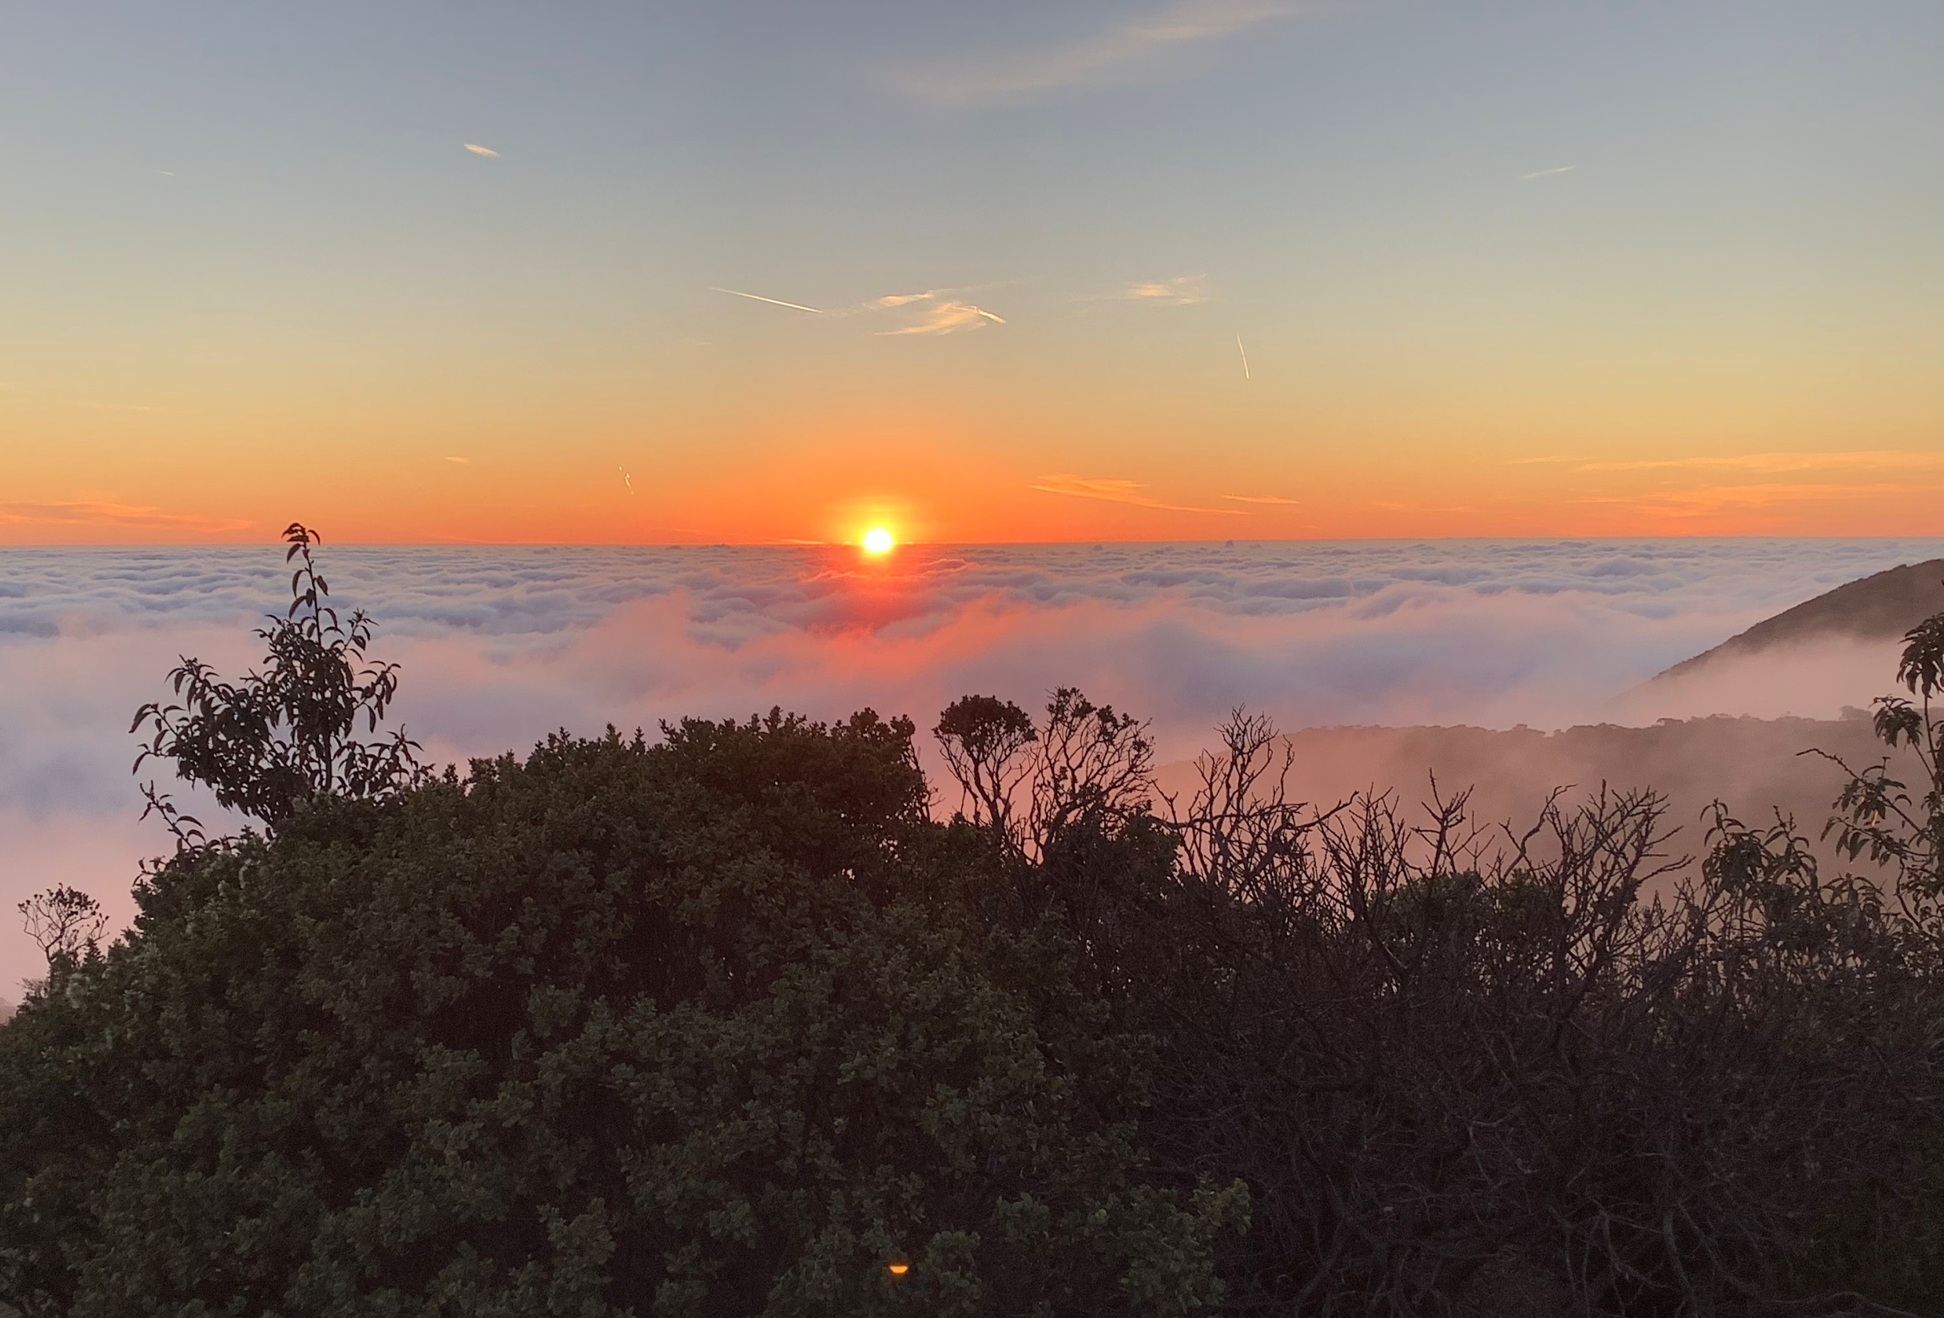
Mitigated Negative Declaration PLN2017-00135 (AT&T), PLN2006-00075 (Metro PCS) 3501 Whiting Ridge Rd. Montara, California

Slide 2
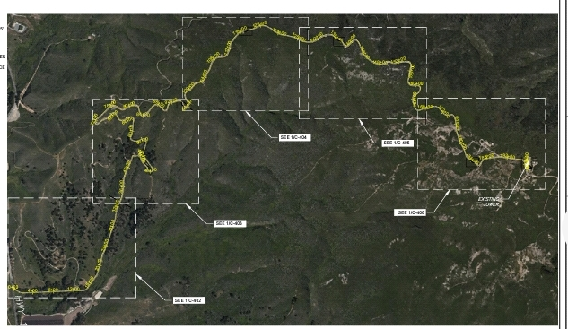
Widening 3.7 miles of Access Road 5 new turnouts/turnarounds

Slide 3
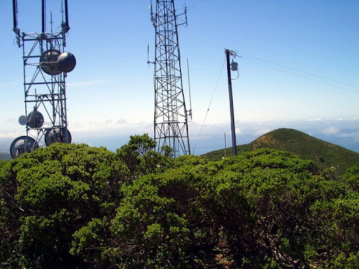
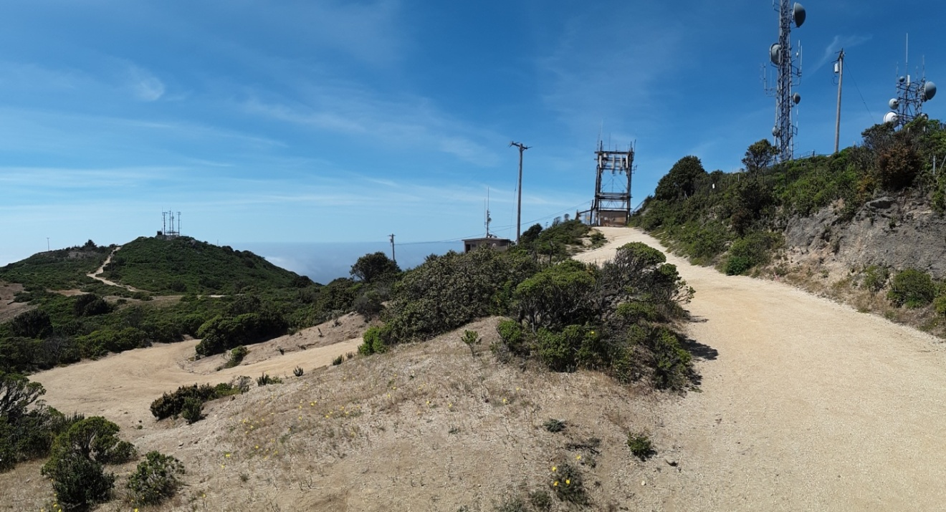
After-the-fact permit for Towers
Montara Mountain Peak

Slide 4
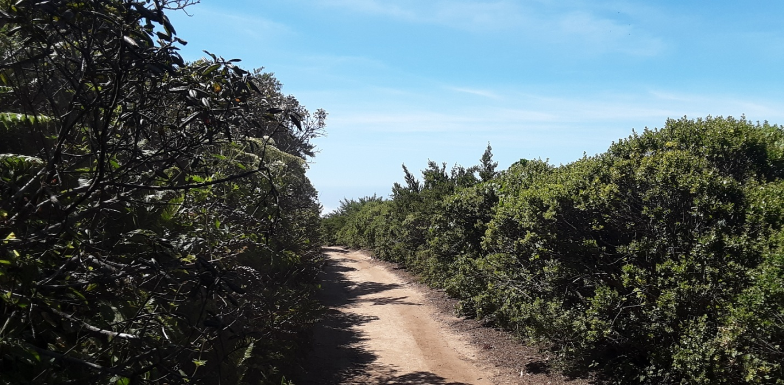
Widen to 12-15 feet 2-7 feet of vegetation clearing

Slide 5
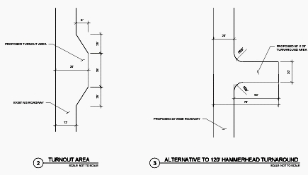
Turnouts & Hammerhead Turnaround
Why needed when there already are 5+ utility clearings?

Slide 6
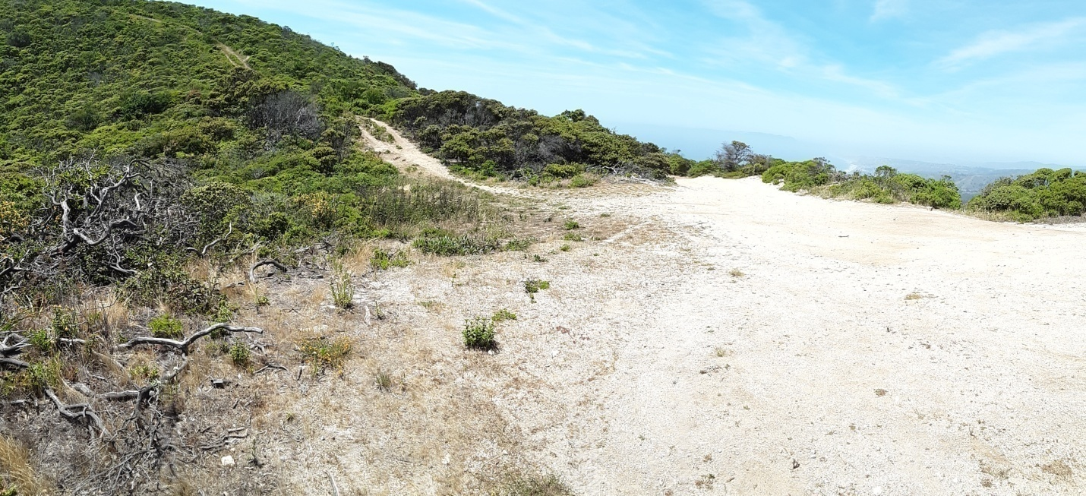
Many clearings created by previous utility maintenance work have the same dimensions of the new emergency vehicle turnouts.
Station 138+00 also has an existing utility road that was used by bucket trucks as a hammerhead turnaround.

Slide 7
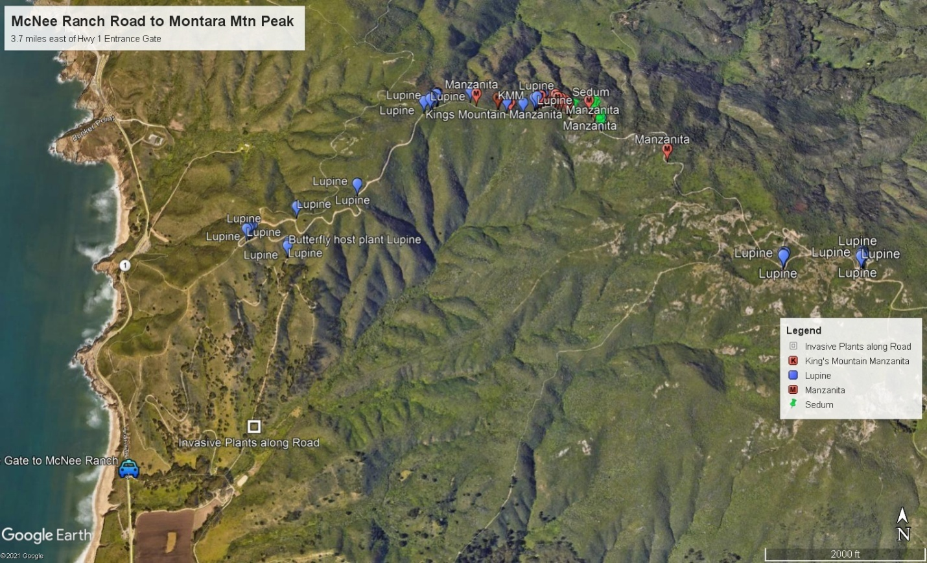
Impacts to Rare Manzanitas, Endangered Butterfly Host Plants & Sensitive Northern Maritime Chaparral

Slide 8
Minimization Measures
Fire Prevention for high fire danger area
Environmental Training for all workers
Nesting Bird Surveys prior to construction
Rare Plant Surveys for avoidance
Butterfly Host Plant Surveys for avoidance
Invasive Plant Minimization
Post-construction Invasive Plant Monitoring

Slide 9
MND Corrections
Aesthetics 1.g. Should be marked SIGNIFICANT as grading and new turnouts will visually intrude into an area having natural scenic qualities.
Biological Resources 4.a. Discuss impacts to rare manzanitas and butterfly host plants
Biological Resources 4.d. Discuss impacts from grading and vegetation removal to nesting birds

Slide 10
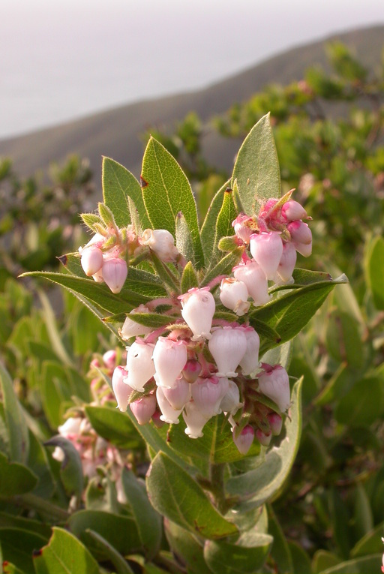
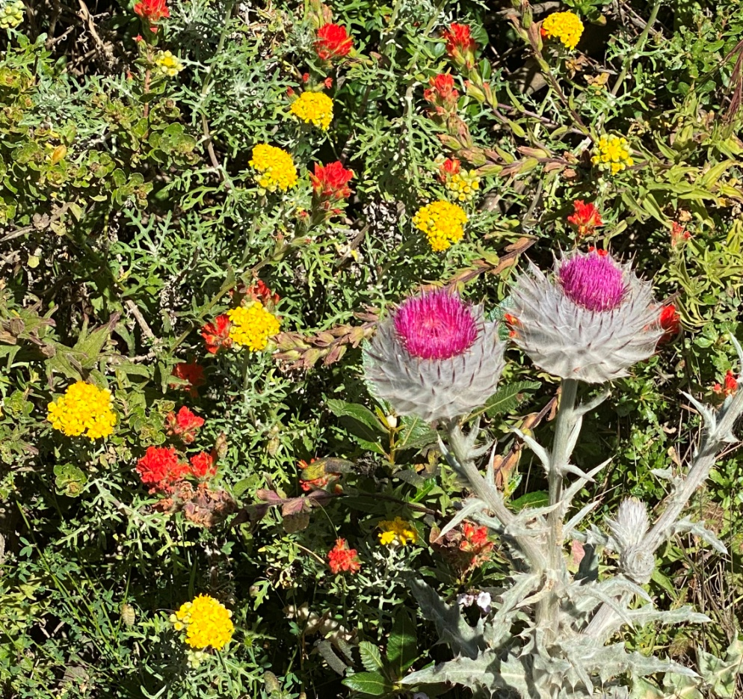
Montara Manzanita
The construction of new turnouts/turnarounds and grading (widening)
will remove 40,000+ square feet of native coastal scrub
This is NOT described in the MND

