Slide 1
Hot Zone: Perspectives on the (Next) Pandemic
Sten H. Vermund, MD, PhD (sten.vermund@yale.edu)
Yale School of Public Health (https://publichealth.yale.edu/profile/sten_vermund/)
<number>

Slide 2
How do we manage pandemics in the future?
Tackle at the source (e.g., Ebola in West Africa; Coronavirus in China)
Reform & revitalize international agencies, e.g., WHO, UNICEF, PAHO
Global viral surveillance and local response (capacity building)
Revitalize public health infrastructures & workforces, esp. CDC & state DPH
Coordinate emergency responses, as for natural disasters like fire
Improve logistics and supply chains for vital consumables
Address social determinants of risk
Take warnings seriously for vaccine development (e.g., Ebola, SARS)
Attend to climate change (zoonotic diseases) & unmet need for contraception (unwanted pregnancies)
sten.vermund@yale.edu

Slide 3
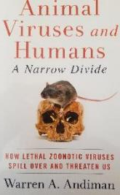
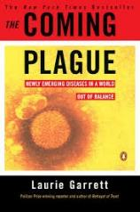
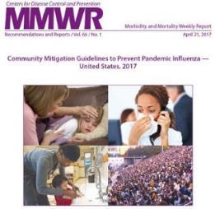
Prepare for & mitigate pandemic threats
Recent events were not surprises…
1918-1919 Spanish influenza → subsequent flu pandemics (1957, 1968, 2009)
CoV cold viruses x4, then SARS, then MERS
Ebola of 2014-2015 was one of 22 outbreaks from 1976 through 2021 (19 countries) https://www.cdc.gov/vhf/ebola/history/chronology.html
Public health financing in India ≈1.5% of GDP, so capacity to respond is minimal
100s of reviews of pandemic threats, e.g., Fedson DS. Pandemic influenza and the global vaccine supply. Clin Infect Dis 2003

Slide 4
How do we manage pandemics in the future?
Tackle at the source (e.g., Ebola in West Africa; Coronavirus in China)
Reform & revitalize international agencies, e.g., WHO, UNICEF, PAHO
Global viral surveillance and local response (capacity building)
Revitalize public health infrastructures & workforces, esp. CDC & state DPH
Coordinate emergency responses, as for natural disasters like fire
Improve logistics and supply chains for vital consumables
Address social determinants of risk
Take warnings seriously for vaccine development (e.g., Ebola, SARS)
Attend to climate change (zoonotic diseases) & unmet need for contraception (unwanted pregnancies)
sten.vermund@yale.edu

Slide 5
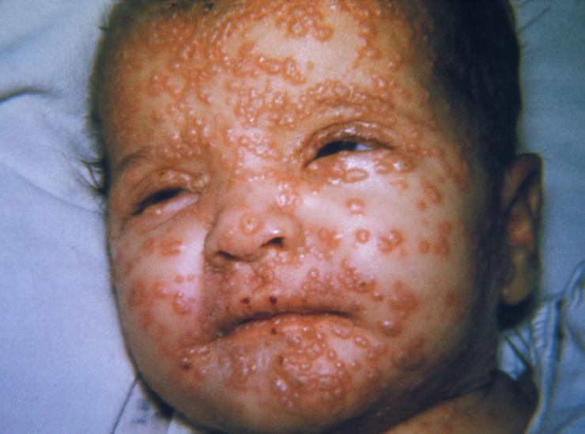
Intelligent policymaking in lieu of partisanship
USSR & USA spearheaded global smallpox eradication in the 1950s
Global investment of $300 million saved $1 billion/yr smallpox vaccination costs in USA alone, when vaccinations ceased in 1980s, a fantastic ROI
In 2003-2004, a broadly bipartisan bill to support the U.S. President’s Emergency Plan for AIDS Relief was signed by President George W. Bush
Now with >$90 B spent, it is the largest ever global public health investment
Political vs. Partisan in Science
Political: influence legislation & regulation through public affairs for the community
Partisan: activities have a firm adherence to a party, faction, or person
2003 House PEPFAR vote was 375 – 41; Renewal Senate vote in 2008 was 80-16
5

Slide 6
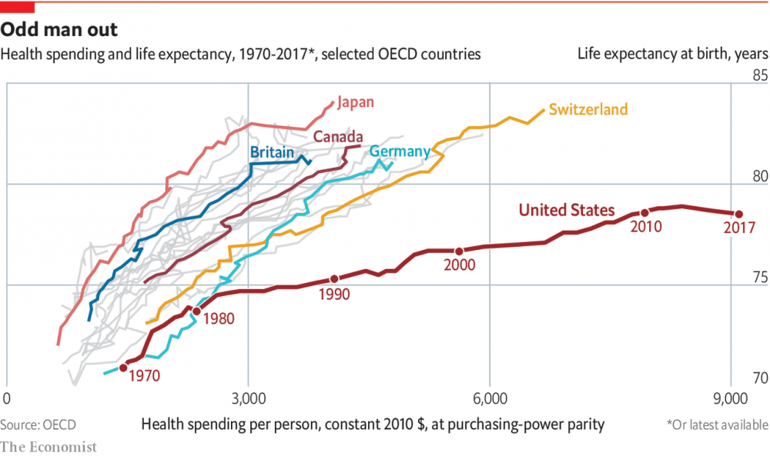
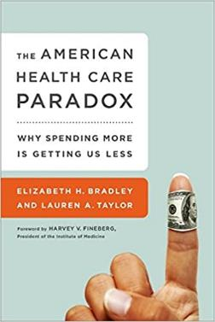
Bipartisan U.S. healthcare reform needed to highlight prevention and relevant social investments to improve a comparatively inefficient & ineffective system
Book cover courtesy of amazon.com
5

Slide 7
Est. shortfall in the U.S. public health workforce
“The Public Health Workforce Shortage: Left Unchecked, Will We Be Protected?” American Public Health Association in 2006
Updated April 5, 2020: “A deficit of more than 250,000 public health workers is no way to fight Covid-19” https://www.statnews.com/2020/04/05/deficit-public-health-workers-no-way-to-fight-covid-19/
Yale School of Public Health is one of 60 accredited schools in the US (4 in New England) vs. 180 medical schools
Endowment supports 13% of budget vs. 50% for all Yale schools
Student demand exists, but limits in affordability (generalizable to other schools of public health, but some mitigation with naming gifts)
7

Slide 8
How do we manage pandemics in the future?
Tackle at the source (e.g., Ebola in West Africa; Coronavirus in China)
Reform & revitalize international agencies, e.g., WHO, UNICEF, PAHO
Global viral surveillance and local response (capacity building)
Revitalize public health infrastructures & workforces, esp. CDC & state DPH
Coordinate emergency responses, as for natural disasters like fire
Improve logistics and supply chains for vital consumables
Address social determinants of risk
Take warnings seriously for vaccine development (e.g., Ebola, SARS)
Attend to climate change (zoonotic diseases) & unmet need for contraception (unwanted pregnancies)
sten.vermund@yale.edu

Slide 9
We left promising vaccines on the shelf until AFTER the crises began
Ebola vaccine available before 2009 responding to DRC outbreaks, but not tested in earnest until 2015 West African crisis in Guinea, Liberia, and Sierra Leone
Jack Rose at Yale: https://www.statnews.com/2020/01/07/inside-story-scientists-produced-world-first-ebola-vaccine/
Est. investment in West Africa $300 million; spent in US response >$2 billion
SARS and MERS coronavirus vaccines developed in the 2004-2016 period.
None tested or completed until SARS-CoV-2 pandemic led to emergency vaccine work
SANOFI vaccine dropped due to business considerations, for ex. Need for public-private partnerships. Why do SARS-COV vaccines not exist? The pharma scientific intelligence and business model must be revisited! Boudjelal M et al. Expert Opinion on Drug Discovery 2020; DOI: 10.1080/17460441.2020.1777980
Also left on the shelf were surge capacity plans for:
Personal protective equipment (e.g., masks, ventilators, MERV 13 air filters)
Workforce for nursing homes, hospitals, and contact tracers
Reminds us of Hurricane relief failures (Katrina and others)
9

Slide 10
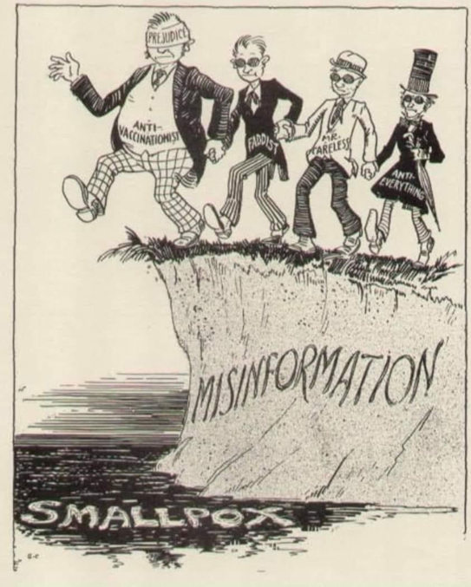
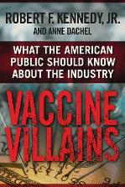
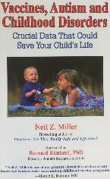
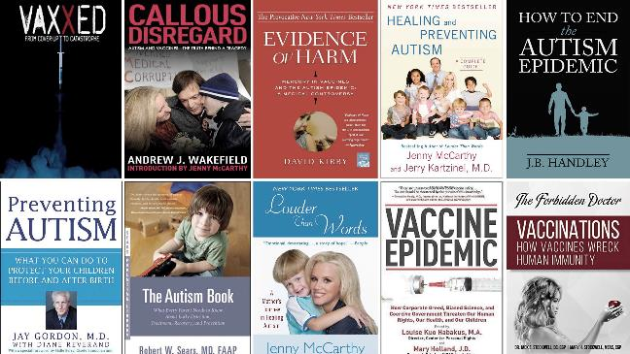
Not just the vaccines themselves; Vaccine confidence essential

Slide 11
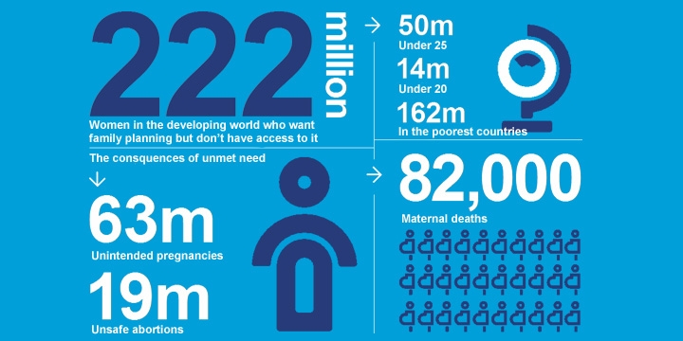
Continuing pandemic risks emege from population pressures > Global pop 2.4 B in 1954, now 7.8 B Massive unmet need for contraception among women who want it

Slide 12
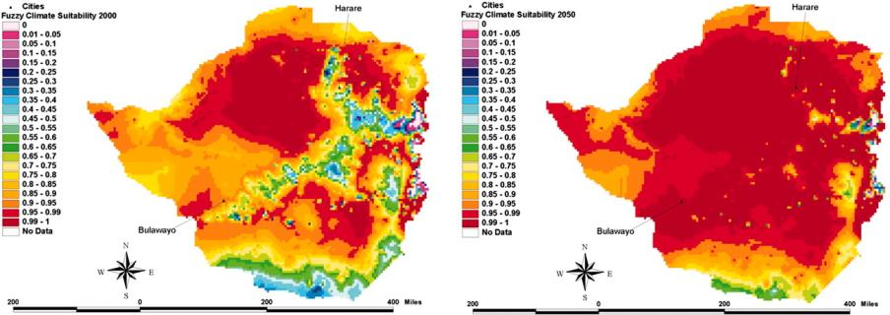
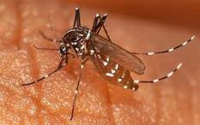
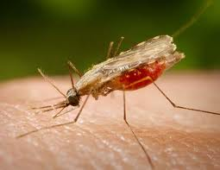
Spread of vector-borne diseases favored by warmth, moisture
Water-borne diseases like cholera
Mosquito-related infections
Malaria, Dengue Fever, Yellow Fever, Zika virus, many other arboviruses
Other vector-related infections
Filariasis/Onchocerciasis, Schistosomiasis, Hantaviruses, Trypanosomiasis, Rickettsiosis
Drought-flood cycles, hunger, climate refugees
Malaria projections in Zimbabwe due to warming, 2000-2050

Slide 13
Future pandemics are a certainty
Must fill gaps in public health supply chain and workforce, both in the USA and globally
Disproportional attention to curative medicine is inefficient; we must prevent root causes of disease and mitigate risk
Rapid response planning is essential with public-private partnerships
A longer view of public health is needed (not “problem-of-the-week”)
Global equity to prevent and/or respond to the next pandemic
Human rights and humanitarian rationale
Build the global reputation of the USA
Save us trillions of dollars and massive human suffering in the long run
13

Slide 14
sten.vermund@yale.edu
13

Slide 15
Q&A if vaccine hesitancy arises from audience
13

Slide 16
Vaccine enthusiasm vs. hesitancy: Now a partisan issue, surprisingly
If a coronavirus vaccine is determined to be safe by scientists and is available for free to everyone who wanted it, would you get it? --definitely, --probably, --probably not, --definitely not?
What are the predictors of vaccine hesitancy (wait & see) & vaccine opposition (only if required or definitely not)?
KFF COVID-19 Vaccine Monitor
https://www.kff.org/6787d74/

Slide 17
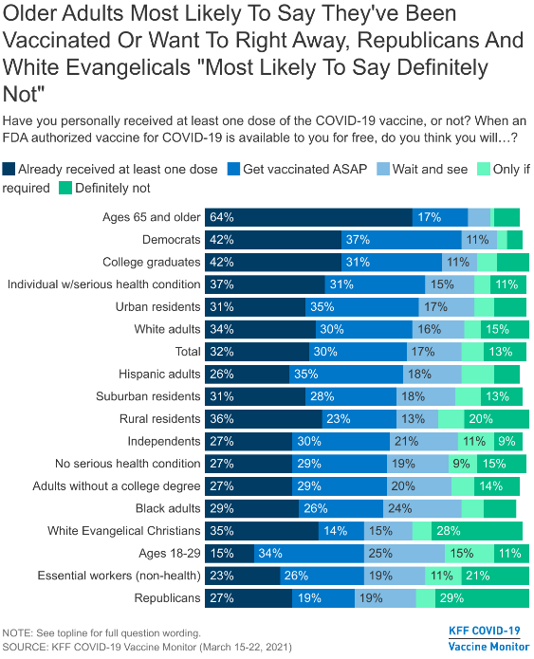
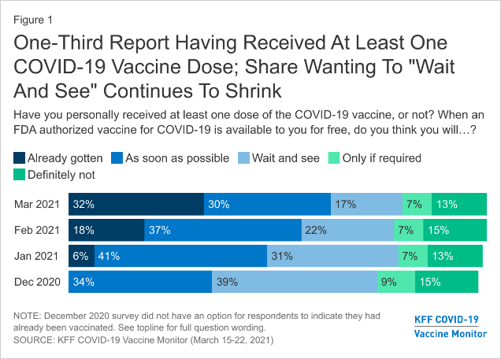
% definitely or probably will get a vaccine if deemed safe by scientists & available for free https://www.kff.org/6787d74/

Slide 18
Personality, Partisanship, & COVID-19 Protection
Individuals who eschew masks are twice as likely to resent authority and to believe the truth about CoV is being kept from the public
Morgan Freeman PSA, targeting the “wait and see” audience: https://www.youtube.com/watch?v=RU43V0Zt2gA
Dolly Parton’s contribution for a “no vaccine” audience: https://www.youtube.com/watch?v=OjbSWebA3Ko
Resnicow K, et al. Novel Predictors of Coronavirus Protective Behaviors among US adults: The role of trait reactance, conspiracy beliefs, and belief in the apocalypse. J Med Internet Res. 2021 Apr 6. doi: 10.2196/23488. Epub ahead of print. PMID: 33835930.

