Slide 1
HOME, HOPE, HEART
Laura Fanucchi, Associate Executive Director

Slide 2
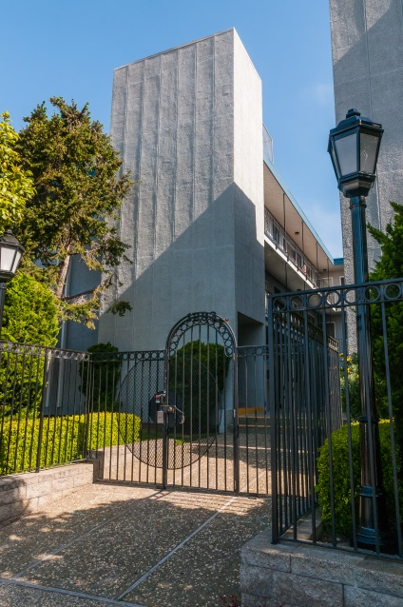
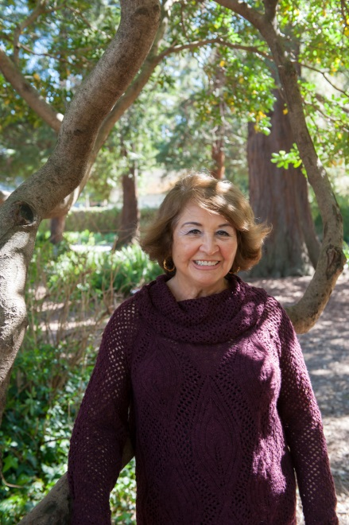
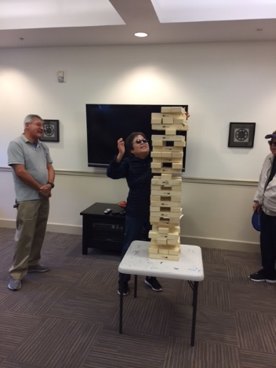
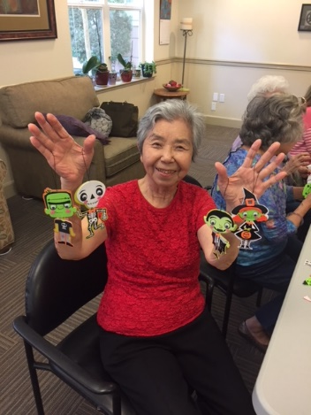
Creative
Affordable Housing Solutions
in San Mateo County
since 1972

Slide 3
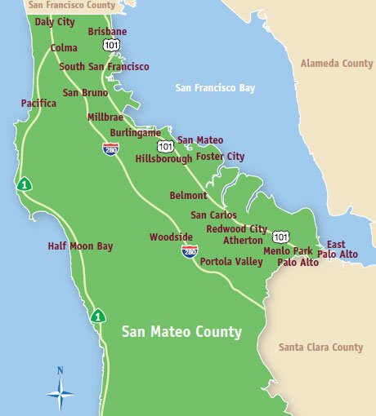
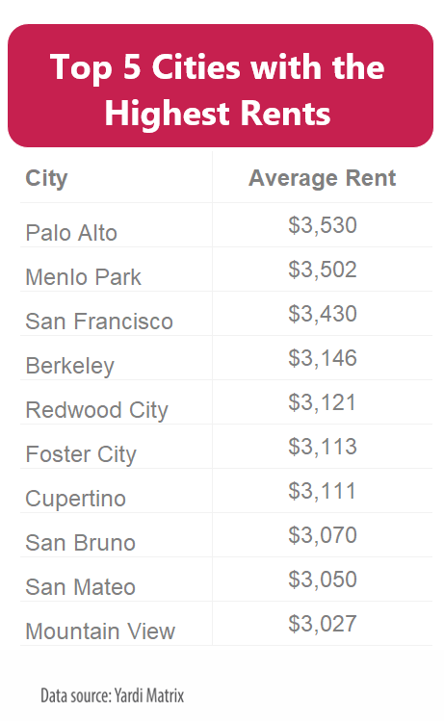
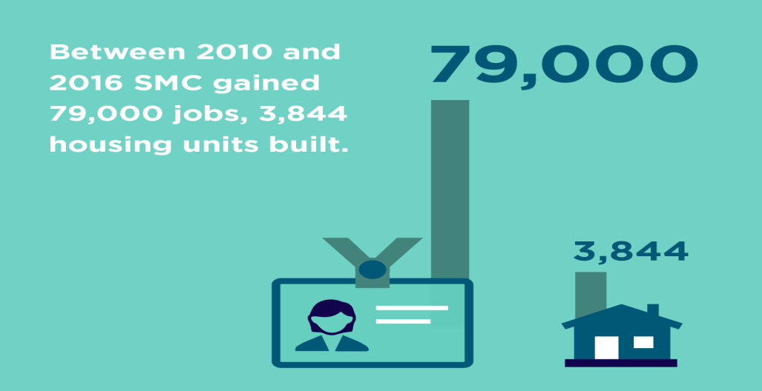
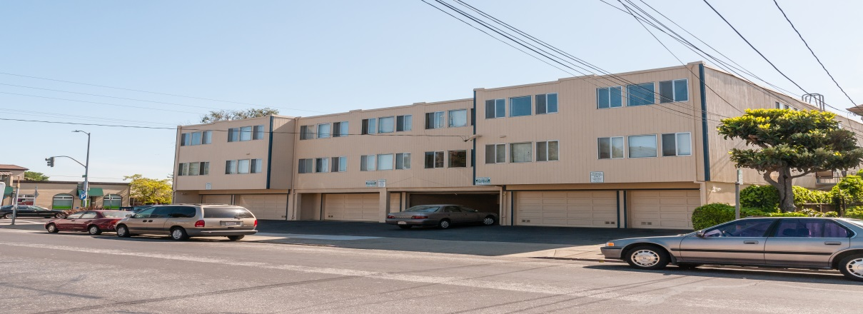
Housing Challenges
Limited Buildable Land
Bay Area Rents
Job Growth
Housing waiting lists

Slide 4
Housing Opportunities
Housing I&R (3,500)
Property Development (650)
Self Sufficiency Program (100)
Home Sharing Program (650)

Slide 5
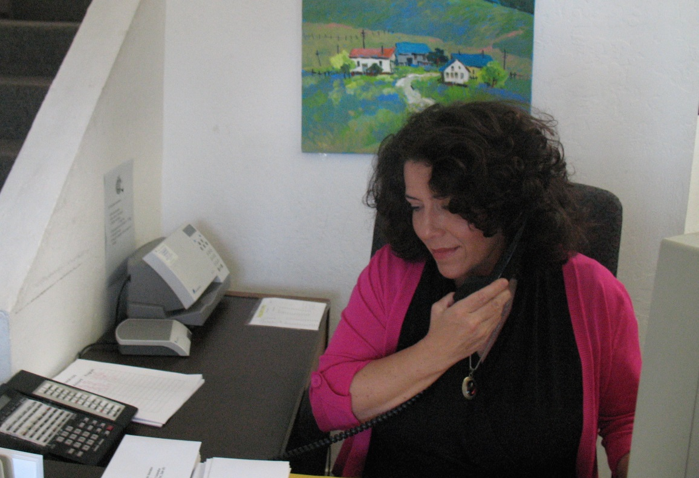
Housing Information and Referral
3,500 inquiry calls per year
(200 from the Coastside cities)
Housing referrals
Community resources

Slide 6
Property Division HIP Housing Development Corporation (HHDC)
17 properties throughout San Mateo County
9 properties managed for 3rd parties
Gateway property in Pacifica
Eight properties have a Section 8 contract

Slide 7
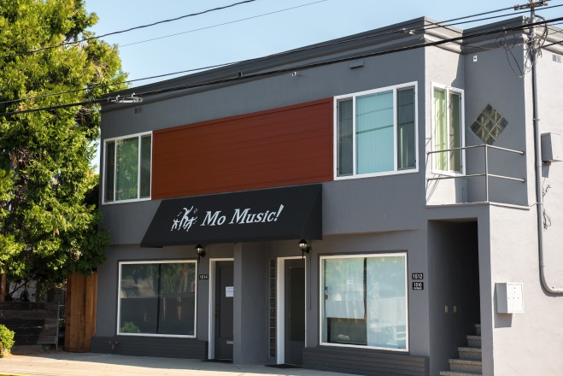
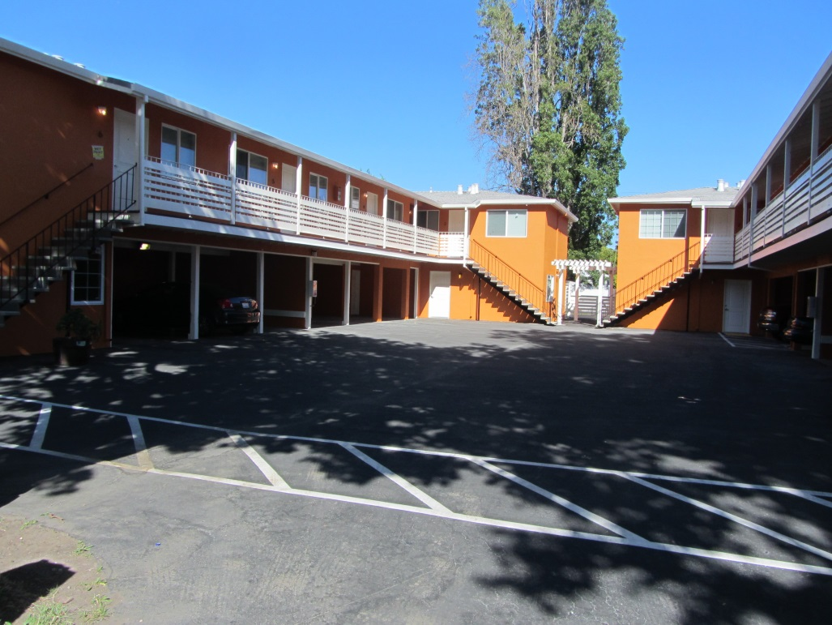
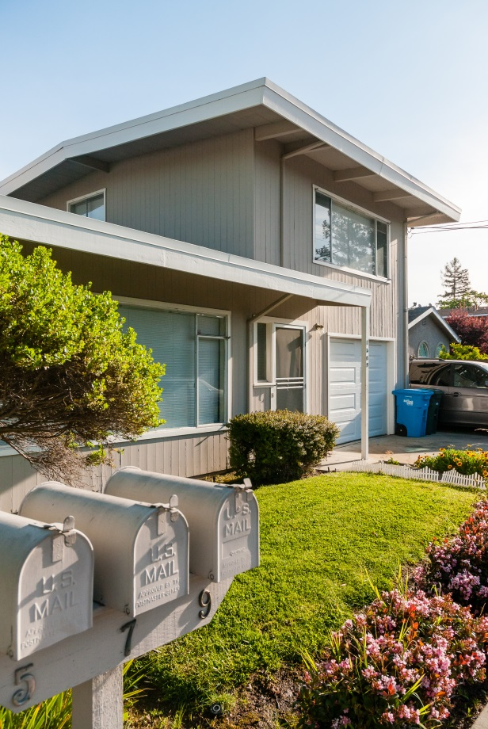
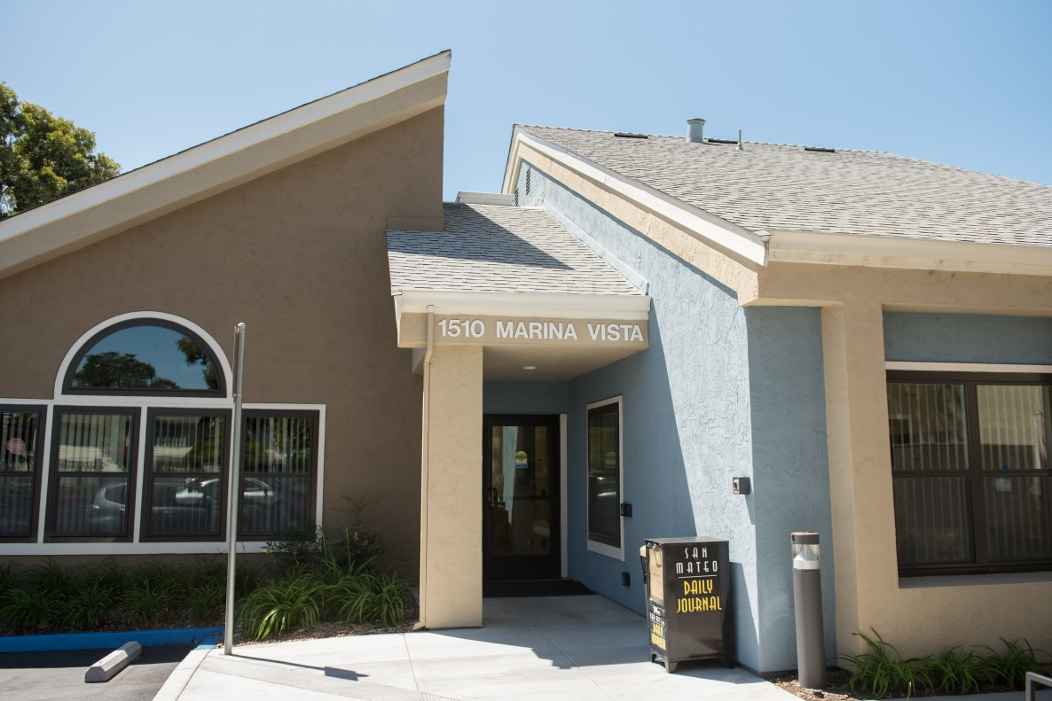
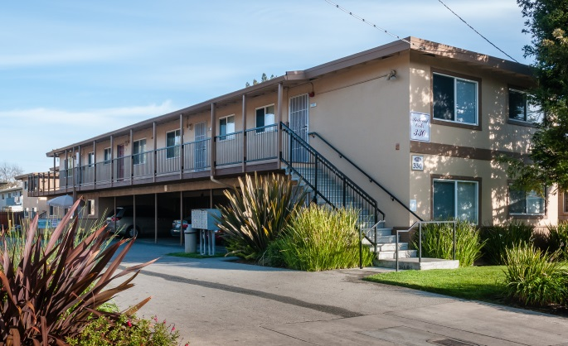
Stafford St., Redwood City
Willow, Menlo Park
Oxford, Redwood City
Redwood Ave., Redwood City
Marina Vista, San Mateo

Slide 8
Self Sufficiency Program
Model welfare-to-work program
50-60 families
In school/job training
Monthly Case management
Life Skills workshops
Community Resources

Slide 9
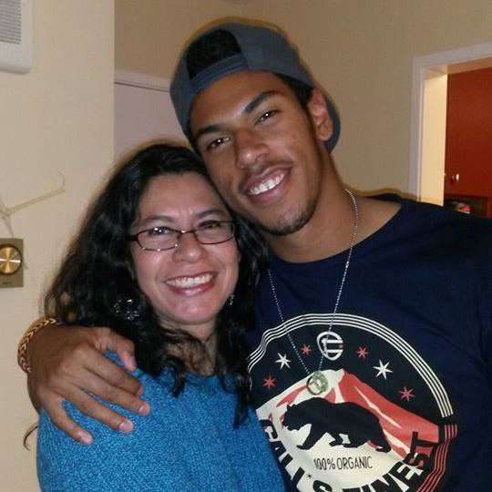
SELF SUFFICIENCY PROGRAM Housing Support Models
Rental scholarship from 1-5 years
4 group share homes
Independent housing
Housing First approach

Slide 10
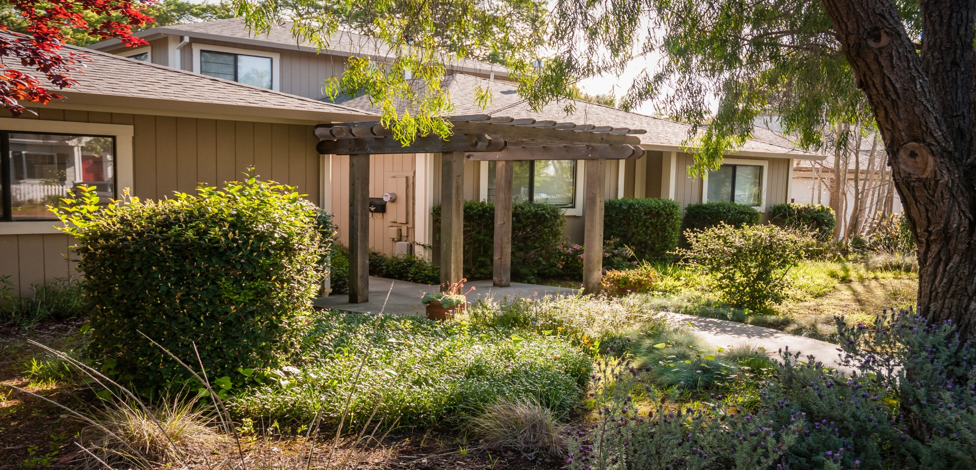
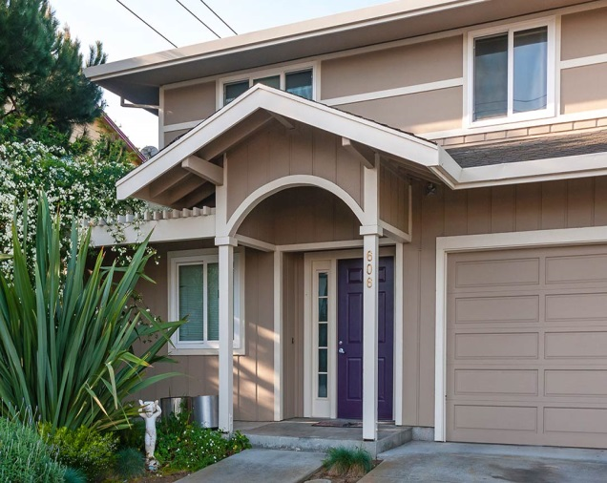
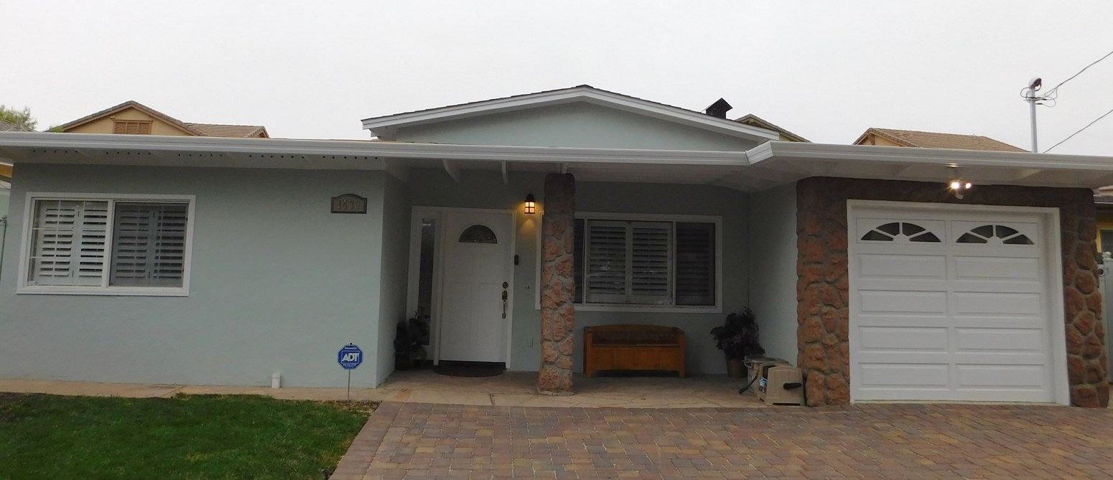
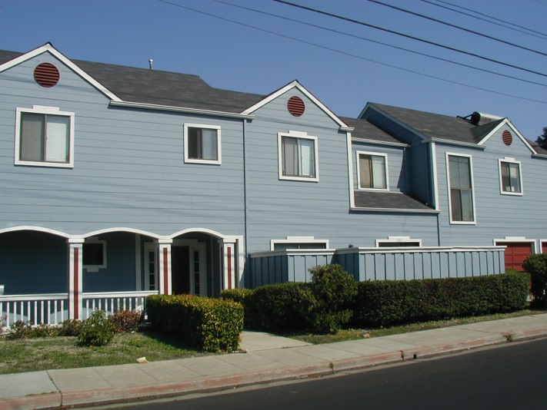

Slide 11
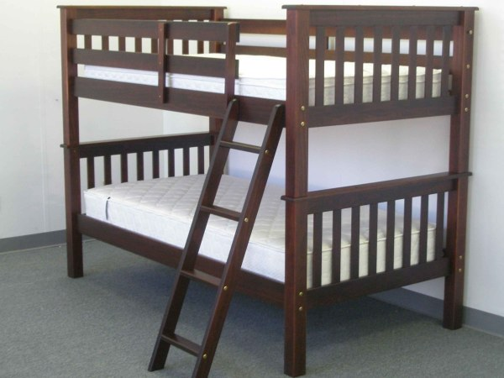
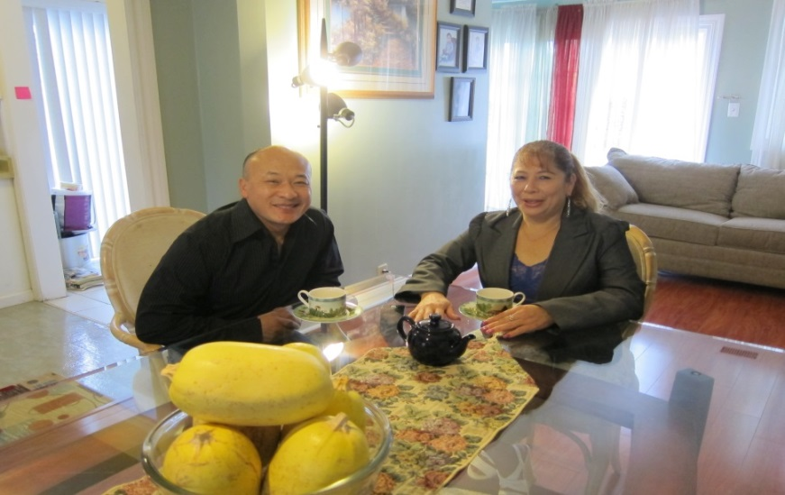
Home Sharing
What society thinks it is
What Media thinks it is
How sometimes we think it can feel
What Home Sharing can be like

Slide 12
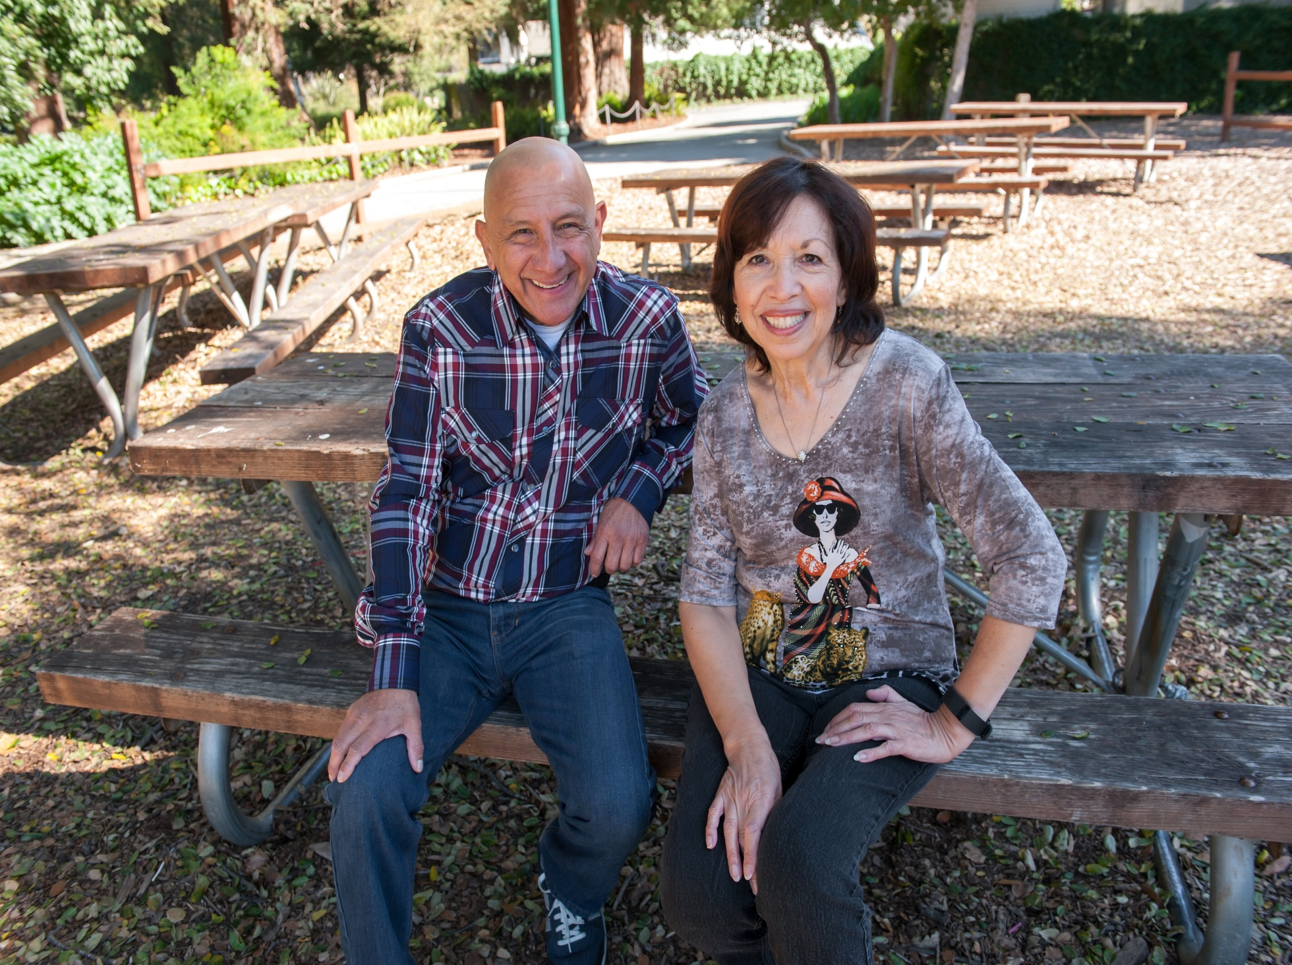
Irene & Cesar’s Video

Slide 13
Long term living arrangement vs. hosting
Existing housing stock
Shared and private space
Rent and Exchange matches

Slide 14
Home Sharing Program
Client Profile
Funding partners
Total served & matched

Slide 15
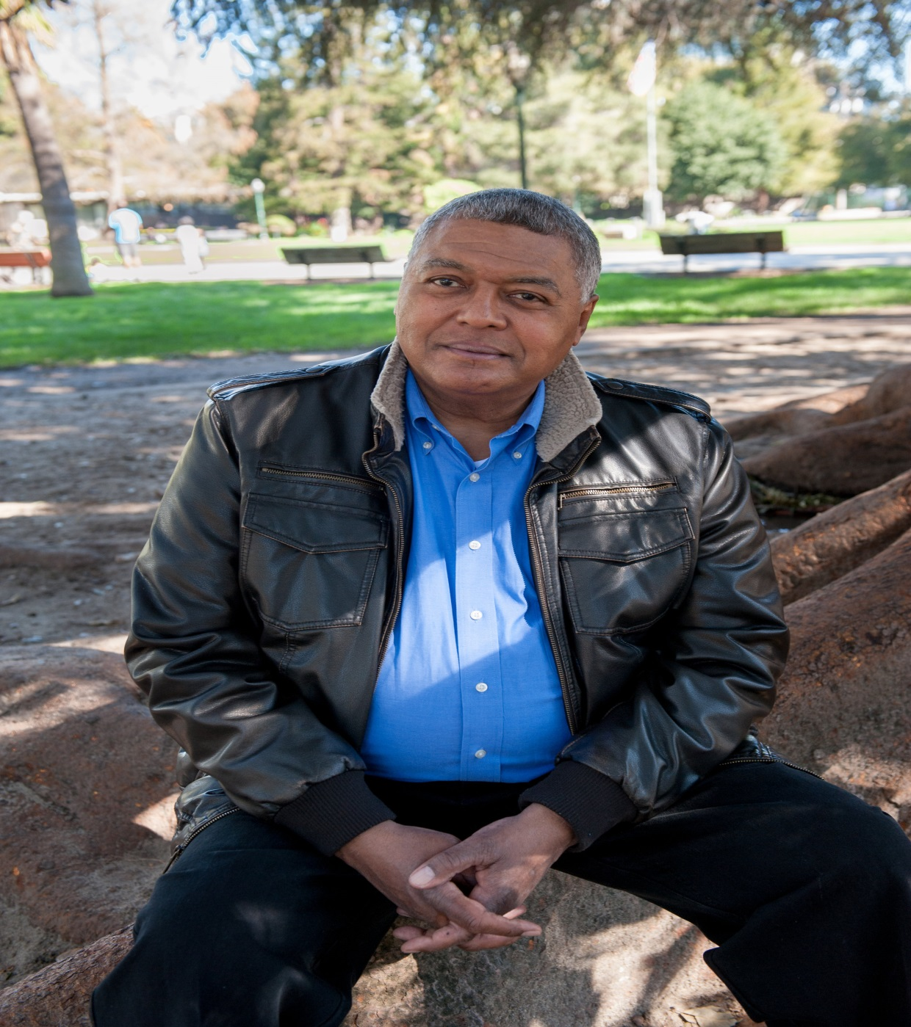
Stories shared by seniors
Displacement trends
Car vs. shelter
Staying in the community
Fighting tooth and nail to keep home
Less isolation

Slide 16
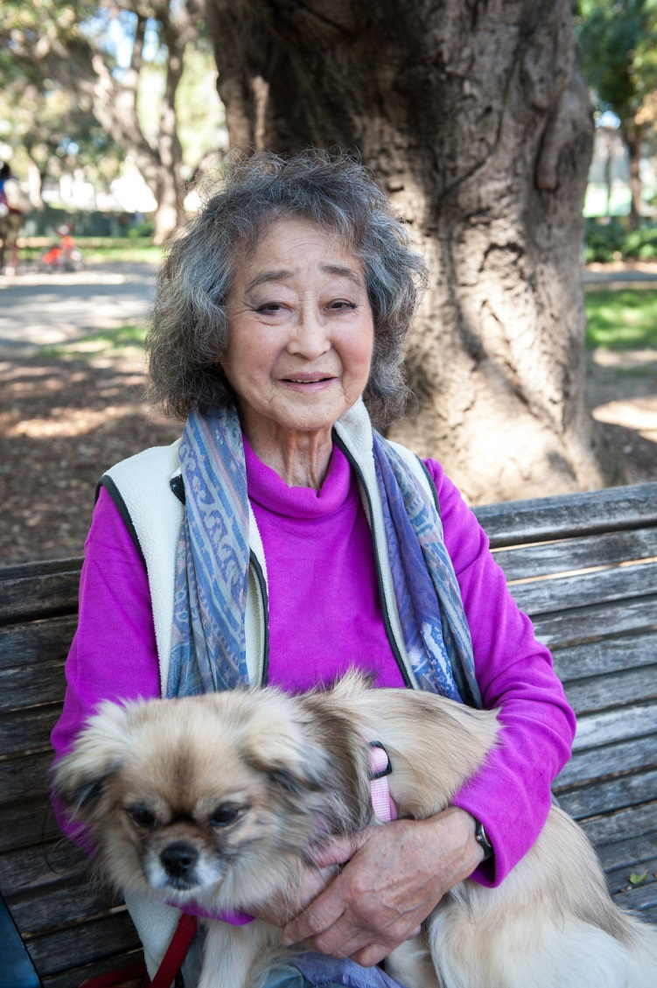
Applicant Screening
Personal interview
Background Search
Income verification
Character References

Slide 17
Matching
Referral Process & Resources
Living Together Agreements
Follow up support/mediation
Notes:
What is Homesharing...
Homesharing is a living arrangement in which two or more persons share a home or an apartment.
Each has his/her private room and shares the common living areas.
HIP’s Homesharing Program matches people with compatible interests and life styles.
HIP facilitates two types of homesharing arrangements: match and service exchange.
In a match arrangement, a home provider is matched with a home seeker, who pays rent.
In a service exchange a home seeker provides a service, such as light cooking, cleaning, or companionship in lieu of or for a reduced rent.
How many of you have heard about it already?
I will explain how Homesharing can be good for you and the community.
Although CID and HIP Housing’s project focuses on persons with disabilities, what I have to talk about will apply to everyone, not just people with disabilities.
I’ve brought with me some people who can share direct experience with Homesharing. Let me introduce ...

Slide 18
Benefits
Promotes financial independence
Aging in place – reduced isolation
Allows work force to stay local
More cost effective than building new
One spare room can change two lives
Notes:
How is homesharing good for you and good for the community
Maintains your financial independence
Puts your extra space to work
Have someone to come home to, share your day with
Helps you to stay in your home.
These are just some of the reasons people home share.
Some of the others are:
Safety
Family/Friends too far away
When away someone is there
Take care better care of myself
Companionship

Slide 19
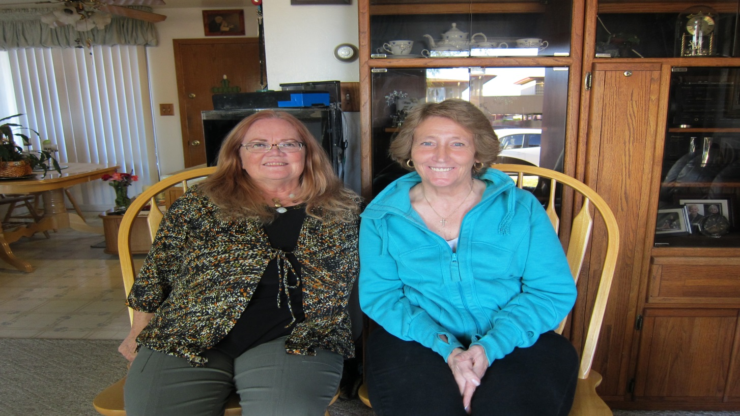
Program Demographics
Home Providers Matched:
66% seniors
78% single female
Average Income $44,000
Average rent $856
40% of income on housing
Home Seekers Matched:
26% seniors
50% single female
Average Income: $39,000
65% homeless/at risk
27% of income on housing

Slide 20
National Shared Housing Resource Center www.nationalsharedhousing.org
Homeshare International
www.homeshare.org

Slide 21
Home Sharing Programs Northern California
Senior Network Services – Santa Cruz
HIP Housing – San Mateo County
ECHO Housing – Livermore and Petaluma
COVIA – Marin, San Francisco, Contra Costa, Fremont
Catholic Charities of Santa Clara County
SHARE of Sonoma County – Sonoma County
Napa Valley Community Housing – Napa
Home Share SLO – San Luis Obispo

Slide 22
Call 650-348-6660
Visit hiphousing.org
Laura Fanucchi
lfanucchi@hiphousing.org
650-348-6660 x 303

