Slide 1
FRS Radio Basic Training
For Coastside CERT Branches 1 & 2
Neighborhood Communications
v.2018081

Slide 2
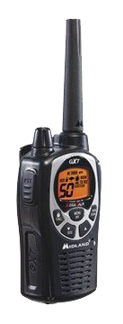
The CERT team: Basic disaster communications
Coastside Emergency Operations Center (CEOC)
Coastside CERT Branches 1 & 2
We use FRS radios for neighborhood communications.
CERT Team #1
CERT Team #2
CERT Team #3

Slide 3
Communications
Neighborhood Command Post must maintain communications with all teams during an incident.
Use whatever works: phone, cell, texting, pen and paper, smoke signals ....
But when all else fails, radio still works.
To be effective, we need to learn Emergency Radio Communications!

Slide 4
About FRS radios
Also known as “Walkie Talkies”
No license required.
22 FRS channels available since 2017.
Shares channels 1-7 and 15-22 with GMRS since 2017.
Many FRS radios only work on Channels 8-14 but may be numbered 1 - 7.
Channels 15-22 are GMRS-FRS and GMRS Repeater outputs.
Typical 0.5 - 1.25 mile communication
Very low power, 1/2 watt ERP (Effective Radiated Power).
New designs since 2017 will output 2 watts of power.
Low cost

Slide 5
FRS channels
2017 GMRS/FRS Frequency Chart
Channel | Frequency | FRS Power | FRS Bandwidth | GMRS Power | GMRS Bandwidth | Notes/Usage
01 | 462.5625 | 2 W | 12.5 kHz | 5 W | 25 kHz | (1) Unofficial national calling channel
02 | 462.5875 | 2 W | 12.5 kHz | 5 W | 25 kHz | (1)
03 | 462.6125 | 2 W | 12.5 kHz | 5 W | 25 kHz | (1)
04 | 462.6375 | 2 W | 12.5 kHz | 5 W | 25 kHz | (1)
05 | 462.6625 | 2 W | 12.5 kHz | 5 W | 25 kHz | (1)
06 | 462.6875 | 2 W | 12.5 kHz | 5 W | 25 kHz | (1)
07 | 462.7125 | 2 W | 12.5 kHz | 5 W | 25 kHz | (1)
08 | 467.5625 | 0.5 W | 12.5 kHz | 0.5 W | 12.5 kHz | (1)
09 | 467.5875 | 0.5 W | 12.5 kHz | 0.5 W | 12.5 kHz | (1)
10 | 467.6125 | 0.5 W | 12.5 kHz | 0.5 W | 12.5 kHz | (1)
11 | 467.6375 | 0.5 W | 12.5 kHz | 0.5 W | 12.5 kHz | (1)
12 | 467.6625 | 0.5 W | 12.5 kHz | 0.5 W | 12.5 kHz | (1)
13 | 467.6875 | 0.5 W | 12.5 kHz | 0.5 W | 12.5 kHz | (1)
14 | 467.7125 | 0.5 W | 12.5 kHz | 0.5 W | 12.5 kHz | (1)
15 | 462.5500 | 2 W | 12.5 kHz | 50 W | 25 kHz | (2)
16 | 462.5750 | 2 W | 12.5 kHz | 50 W | 25 kHz | (2)
17 | 462.6000 | 2 W | 12.5 kHz | 50 W | 25 kHz | (2)
18 | 462.6250 | 2 W | 12.5 kHz | 50 W | 25 kHz | (2)
19 | 462.6500 | 2 W | 12.5 kHz | 50 W | 25 kHz | (2)
20 | 462.6750 | 2 W | 12.5 kHz | 50 W | 25 kHz | (2) Unofficial emergency/traveler assistance channel (PL 141.3)
21 | 462.7000 | 2 W | 12.5 kHz | 50 W | 25 kHz | (2)
22 | 462.7250 | 2 W | 12.5 kHz | 50 W | 25 kHz | (2)
Notes:
(1) Shared FRS and GMRS simplex.
(2) Shared FRS and GMRS simplex, GMRS repeater output.
(3) GMRS repeater input.

Slide 6
About GMRS radios
FCC License required, no test ($75 for 10 years)
License covers all family members
GMRS channels 1 - 7 and 15 -22 are shared with FRS
External antennas OK for selected portable radios*
Some GMRS Radios can cover hundreds of square miles via repeaters *
5 watts allowed on shared FRS channels.
GMRS Radios limited to ½ watt on FRS channels 8-14.
Moderate to very high cost.

Slide 7
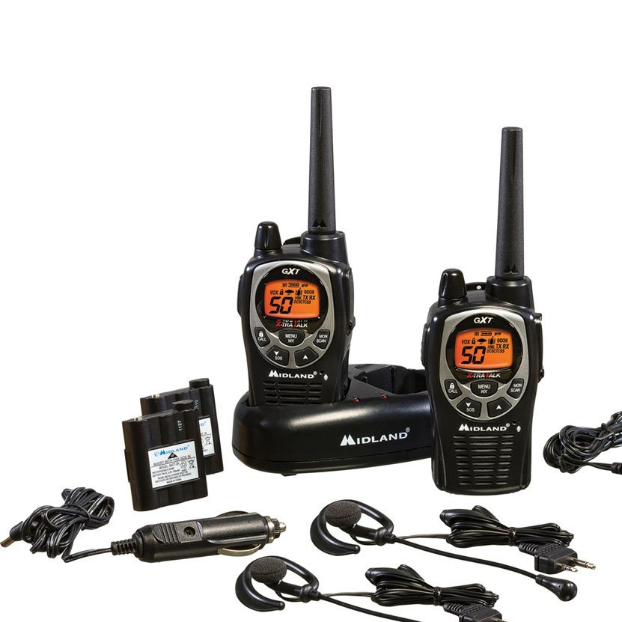
Learning to use your Midland GXT1000 / 1050 radio
Coastside CERT Branches 1 & 2
Recommends:
Midland GXT 1000
This photo shows the complement of equipment included with Midland GXT1000 purchase.

Slide 8
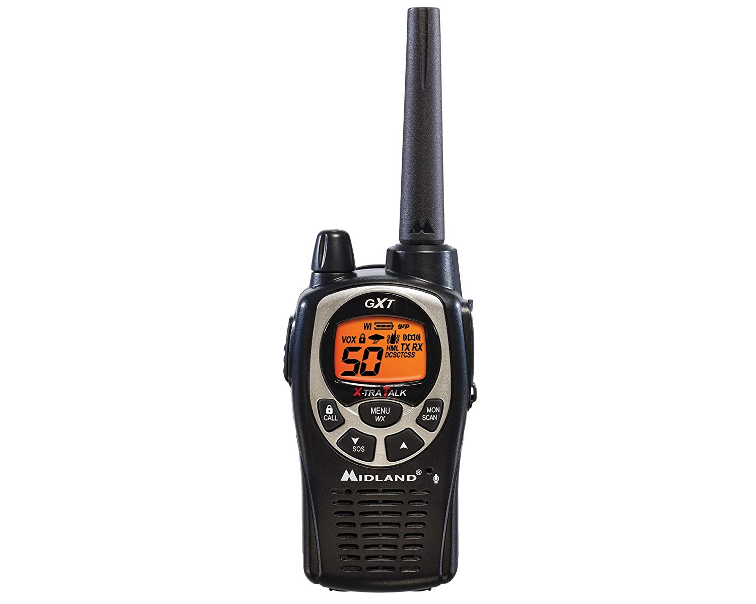
Radio controls: Midland GTX1000
Off-On/Volume Control
Antenna
Channel
Ear Phone Jack
Push-To-Talk (PTT) Switch
Private Line (PL) Code
Keypad Lock & Call Tone
Monitor/Scan Key
Function Up Key
Menu Key
Microphone
Function Down Key
Speaker

Slide 9
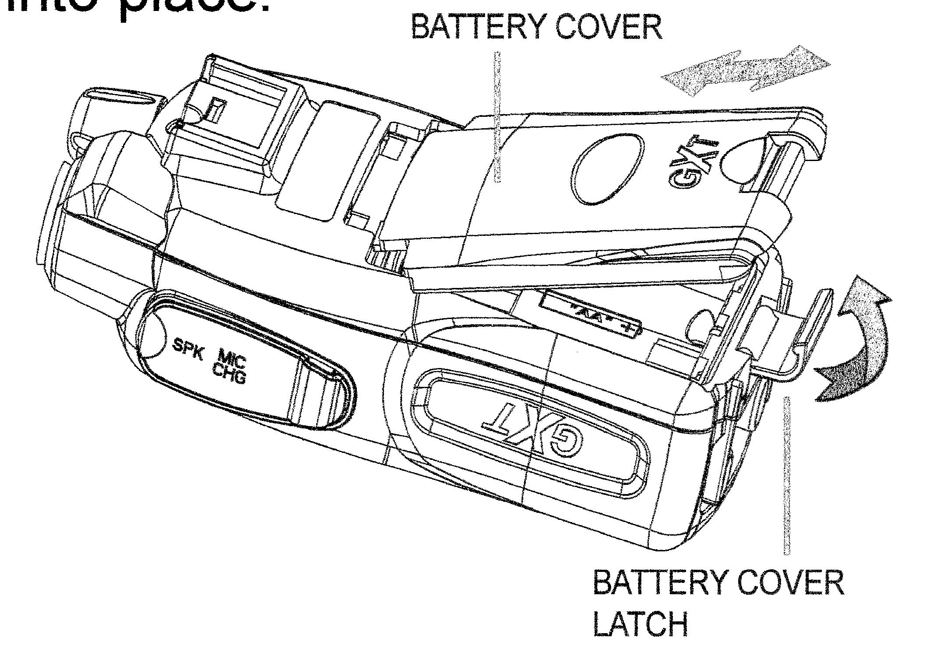
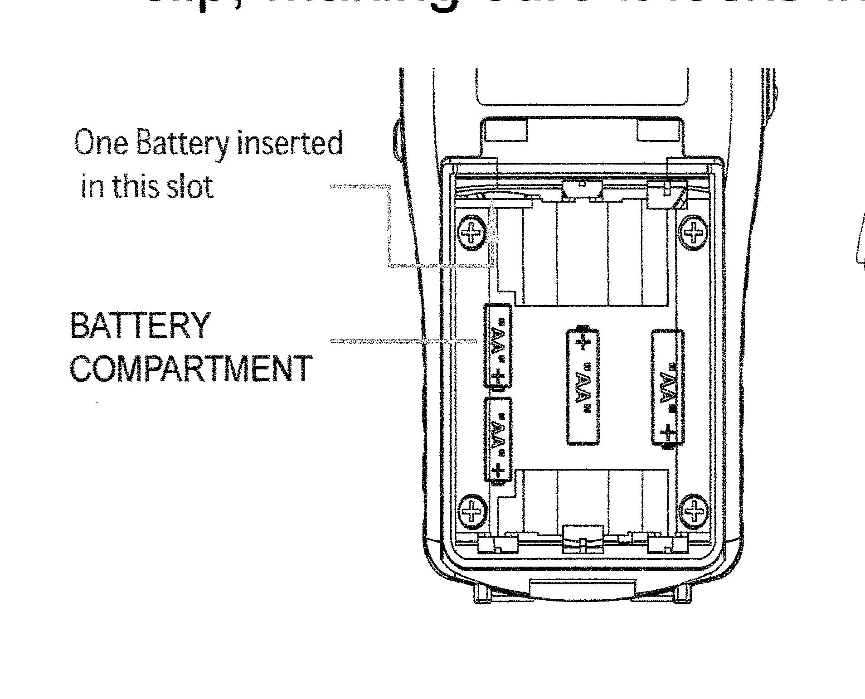
Batteries
Four AA Batteries can be used in place of the supplied Battery Pack.

Slide 10
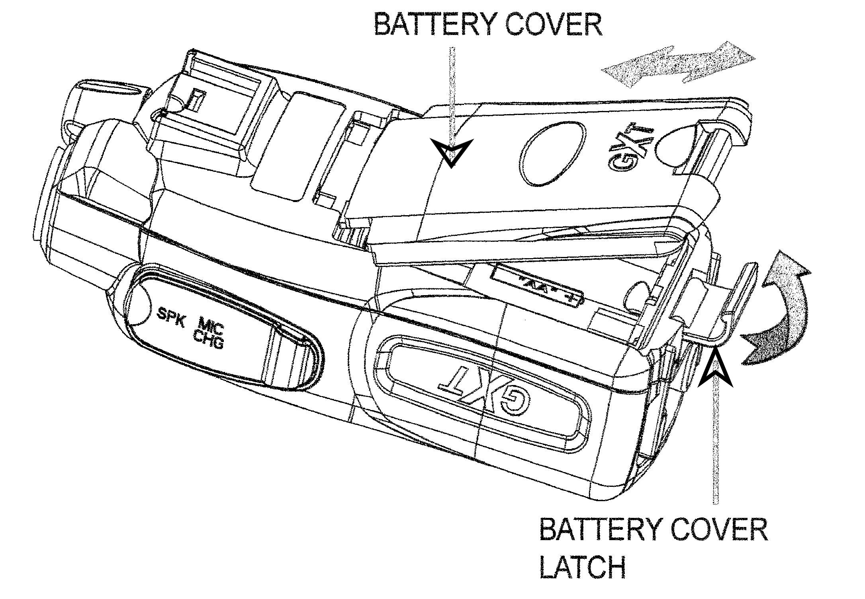
Exercise 1: Battery insertion and maintenance
In this exercise we will review battery changes:
Notes:
Refer class to pages 5 & 6 of radio Introduction phamplett. Show use of AA batteries. Note use of outlet timer on charger. Rechargeable AA batteries to be charged in specific chargers.

Slide 11
Control Notes & Maintaining FRS radios
Radio Controls
On-Off / Volume Control
Channel Selector via MENU Keypad
Functions selected with sequential pressing of the MENU keypad.
‘‘Private’ Line (PL) Codes. (Not used for CERT activities).
Other
Store radios in a safe place with extra batteries & instruction Manual
When radios are not in use, remove batteries as they may discharge accidentally or leak corrosive battery chemistry. Store in plastic baggies.
Use the radios frequently for fun and practice

Slide 12
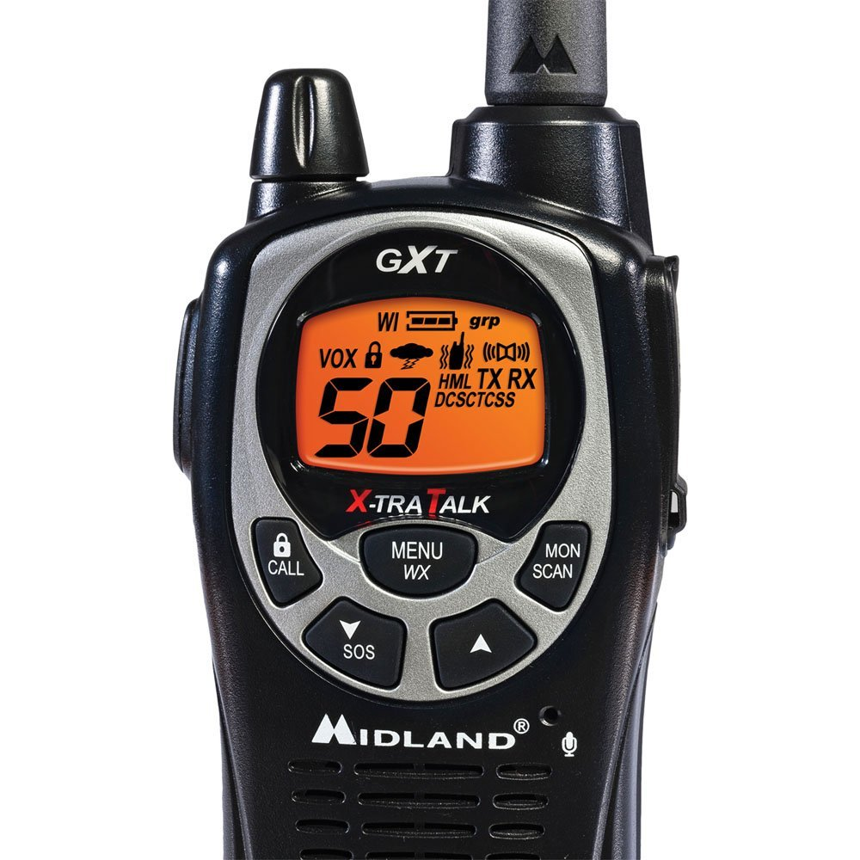
Exercise 2: Working with the keypad lock
In this exercise you will learn use of Keypad Lock:
Keypad Lock Icon
Keypad lock toggles On and Off with 3 Second press of LOCK button
Be aware a short press of this button will send a Ring Tone to all other radios using this channel
Notes:
Have class turn Keypad lock on and off. Show entry on page 7 of radio handout.

Slide 13
What to expect (or why can’t you hear me now?)
Your are too far away from each other
Obstructions
Wrong channel and/or Privacy (PL) Code selected
Other responders may not hear you, too weak, poor location
Channels may be crowded causing interference or noise ( move to alternate channel if required )
Feedback from other channels ( too close )
Someone has VOX enabled, their radio is intermittently transmitting noise or spurous conversations.

Slide 14
Learning to use your radio
Selecting channel and PL ( PL is to be turned OFF during emergencies).
Hold the microphone a fist’s width away from your face
Talk across the microphone, not into it
Speak in a normal voice
Don’t raise your voice
Use clear pronunciation
If adjacent noises obscure your speech shift your location. Don’t talk louder

Slide 15
Additional radio details
PTT = Push to talk
Lock the channel. Don’t accidently switch channel
Spare batteries – You run longer.
Earphones – Listen hands free. Battery lasts longer.
Do NOT use VOX in emergency or group activities.

Slide 16
Exercise 3: Adjusting the channel
In this exercise Adjust your Radio to Channel 8:
Press MENU button Once. Channel number begins flashing.
Press Up or Down Arrow Keys for Channel selection.
Press PTT Button to return to normal operation.
Notes:
Refer class to pages 7 and 8 of the radio handout.

Slide 17
Best practices
Organize your thoughts & follow the protocol.
Write your message out and speak it slowly. Your message is being written down as you speak.
Pass accurate & timely information from the sender to the receiver.
Transmit only when necessary.
Limit your transmission time.
Avoid use of sensitive information over the air. Send personal names, addresses only when necessary.
Use plain English, no TV, CB Slang or “10 codes”

Slide 18
Best practices
Speak slowly and clearly
Avoid pauses on the air. Release PTT when thinking.
Know what you are going to say BEFORE you key the mike
Check for proper channel, GROUP & PL code
Note: Use GROUP “off,” PL Code “0” (none) or “Off” for emergency communications

Slide 19
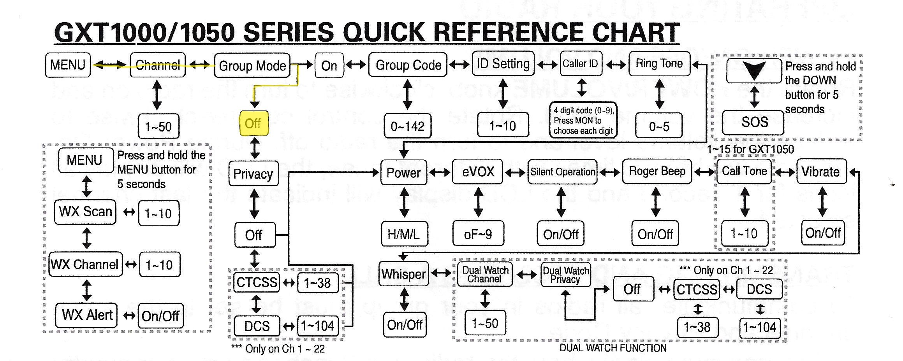
GROUP MODE Not used
In this exercise you will Disable Privacy Codes and see Menu Structure:
Model GXT1000 P removed Group Mode from the operating menu.
Notes:
Refer to instructions on page 7 and 8 of the GXT1000 radio handout.

Slide 20
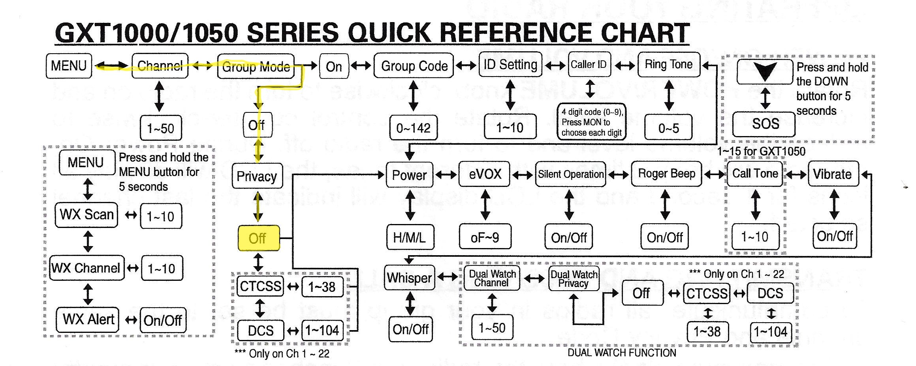
Exercise 4: Disable privacy codes
In this exercise you will Disable Privacy Codes and see Menu Structure:
Notes:
Refer to instructions on page 7 and 8 of the GXT1000 radio handout.

Slide 21
Best practices
Hold radio 3” - 4” from mouth (The width across your knuckles).
Use a function or geographical identification for emergencies such as team name, tactical call, i.e. “Neighborhood Center, Triage, Team 1”
Keep primary Channel clear as possible.
Move lengthy conversations to an unused channel.
Ask “Is this channel in use?” before starting a conversation.
Avoid arguments over the air. Switch channels for off-line conversation.
Acknowledge the receipt of information
Always know the assignment of your channels
Stay calm & courteous if chaos occurs.

Slide 22
Best practices
Communicate triage results:
“Red Tag” (Immediate)
“Yellow Tag” (Delayed)
“Black tag” (Dead)
“Green Tag” (Walking Wounded)
i.e. “We have 3 RED TAG, 12 YELLOW TAG, 6 BLACK TAG, 25 GREEN TAG”
Avoid "stepping" on each other. Keep VOX off to prevent interference.
Always say, OVER when you complete your transmission
Avoid interrupting unless necessary.
Say “BREAK” or “Break - Break” to interrupt with urgent message.
Practice frequently

Slide 23
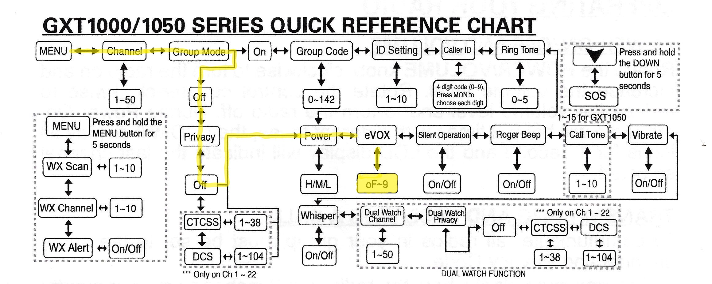
Exercise 5: Turn VOX Off.
Practice Advancing through MENU TREE to turn the VOX selection OFF..

Slide 24
What are Pro-words
Prowords (Procedural Words) were originally developed by the Military to:
Convey maximum information with a minimum of confusion
Keep voice transmission as short and clear as possible.
Radio operators use procedure words (Prowords) to take the place of long sentences.
Best results if receiving radio operator trained using same Prowords.
Best results if radio operators trained with same Phonetic Alphabet.

Slide 25
Some common Prowords
Affirmative – “Yes” (in answer to a specific question)
Break – “I have priority or emergency traffic.”
Clear – “I am finished with this communication.”
Copy – “I acknowledge receipt of message.”
Go Ahead - “You are ready to take other person’s message”
Negative – “No”
Out – see Clear
Over – end of transmission, waiting for response
Roger - "I have received and understand your transmission." It does not mean yes, affirmative, I agree, or I will comply.
This Is - Makes clear who is INITIATING the contact.

Slide 26
The Phonetic Alphabet
Letter | Phonetic |  | Letter | Phonetic |  | Letter | Phonetic
A | Alpha |  | J | Juliet |  | S | Sierra
B | Bravo |  | K | Kilo |  | T | Tango
C | Charlie |  | L | Lima |  | U | Uniform
D | Delta |  | M | Mike |  | V | Victor
E | Echo |  | N | November |  | W | Whiskey
F | Foxtrot |  | O | Oscar |  | X | X-ray
G | Golf |  | P | Papa |  | Y | Yankee
H | Hotel |  | Q | Quebec |  | Z | Zulu
I | India |  | R | Romeo

Slide 27
Compose the message first
Write the message on the message form.
Be brief, 20 words or less.
DO NOT TRANSMIT UNTIL IT IS WRITTEN DOWN!

Slide 28
Just the facts
Give your location. If giving a street address include the name of nearest cross-street if possible. In a countryside setting refer to nearest mile marker or distance and direction from nearest highway intersection.
In general keep the information to 20 words or less. Just the facts!
Break message into 5 word segments so writer can keep up at other end.
Stick to CERT terms: Immediate, Delayed, Minor, Light, Moderate, Heavy, and so on.

Slide 29
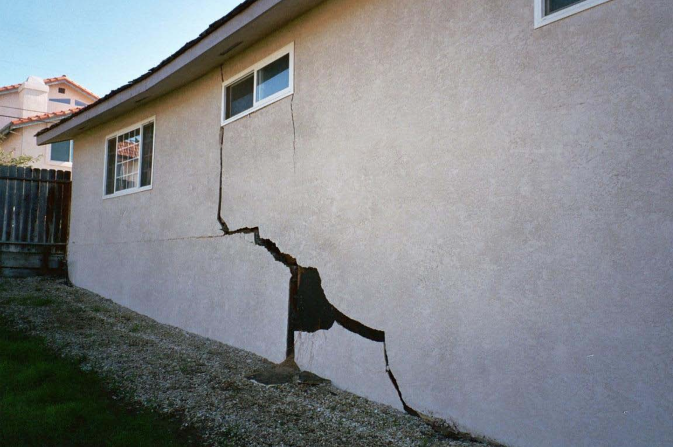
During survey for damage at 78034 Andover St.
Cert Team observes this damaged building.

Slide 30
CERT Team’s Radio report
CERT Team’s radio report of observed damage:
“Poplar Command, Team 4: 78034 Andover Street. Heavy Damage, Over”

Slide 31
Try composing a message for this...
Today: 7:50 PM. Your team discovers a fire in an apartment building. There are people screaming inside. One woman is begging you to help save her baby and her mother in apartment 8. The apartment is at 7452 Iberville. The unmistakable smell of gas is in the air. Your team has discovered seven people with first degree burns.

Slide 32
Try this...
CERT Team’s Radio Report of 7452 Iberville observations:
Today: 7:50 PM. Your team discovers a fire in an apartment building. There are people screaming inside. One woman is begging you to help save her baby and her mother in apartment 8. The apartment is at 7452 Iberville. The unmistakable smell of gas is in the air. Your team has discovered seven people with first degree burns.

Slide 33
Why a log?
When you use the radio, you need to log all messages.
Use the ICS-214. If ICS-214 is not available use your trusty FORM A.
“If it isn’t written down, it did not happen.”
Someone is sure to ask for a repeat of the info 45 minutes ago and 30 messages later.
Enter time of contact before each message.
Number and Date each Log page when filled.
Eventual Reimbursements depend on written records, message logs count!

Slide 34
Passing message traffic
Compose your message before you speak.
Start by listening - Is the channel clear?
If clear, press the transmit button
Then speak, giving call sign of who you are calling, then your call sign.
Then let go of the transmit button
Wait for an acknowledgement.

Slide 35
Passing message traffic
Once acknowledged, wait a second then press the PTT button
Speak, give your call sign, then your message. Slowly.
Then let go of the transmit button
Wait for a confirmation.
If confirmed. Acknowledge with your call sign. You are done.
If not confirmed. Resend message.

Slide 36
Exercise 6: Making and receiving calls
In this exercise you will learn how to:
To transmit (make a call), press and hold the PTT (“Push to Talk”) button. Hold the radio 3 – 4 inches from your mouth and speak normally. Hold it slightly sideways so you are speaking across the microphone to minimize overdriving it.
The TX icon will appear continuously on the LCD Display while transmitting.
To receive, release the PTT button. When you release the PTT button, a “roger beep” automatically signals others that you have stopped transmitting and are ready for a response.
The RX icon will appear on the display when your radio is receiving a transmission. If you cannot hear the transmission well, turn your volume knob clockwise.

Slide 37
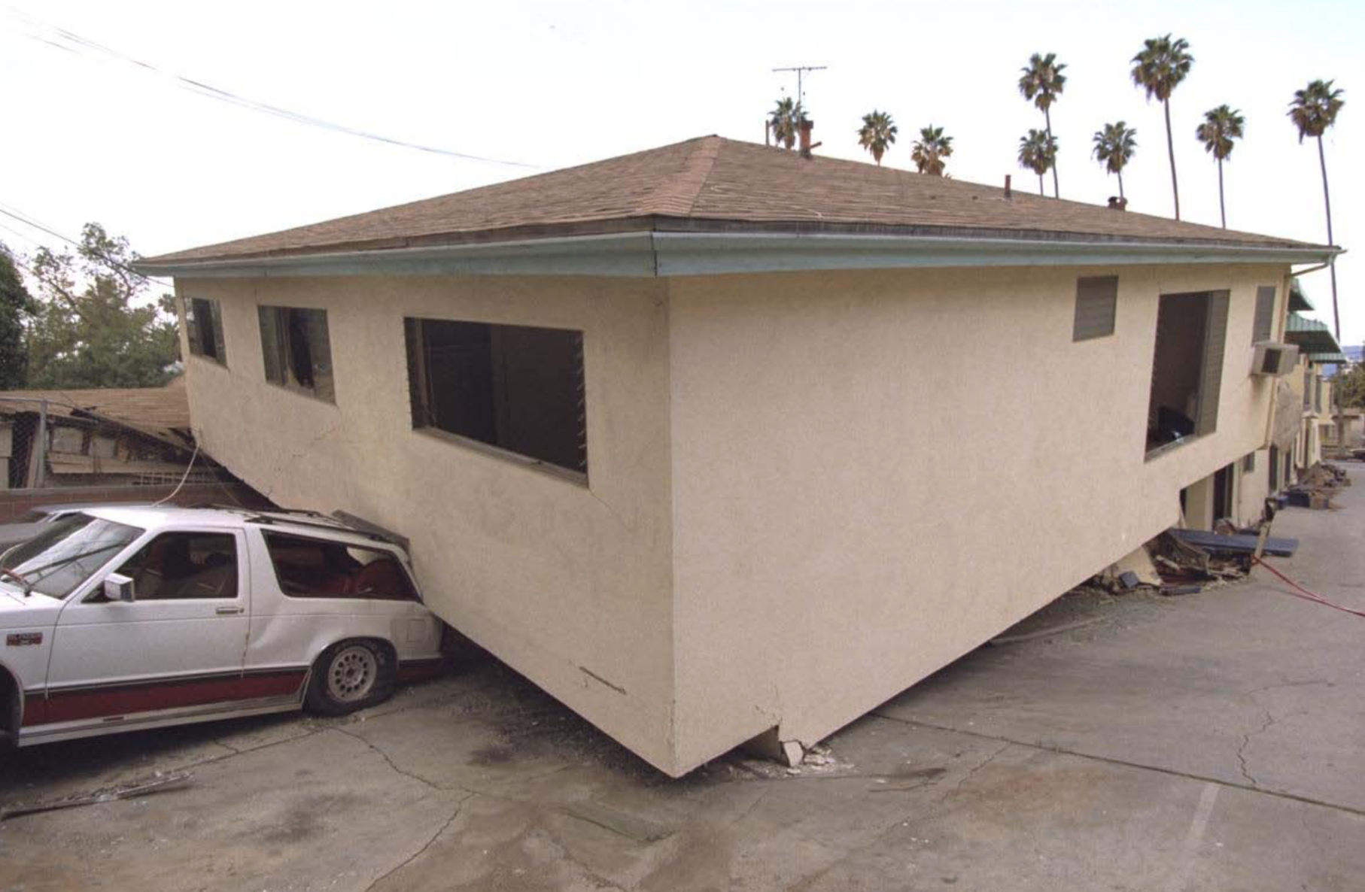
CERT Team observes damage at 2005 Porteous St.

Slide 38
Example: Message passing
On the radio you say: “Spindrift Command, Team 4”
You hear: “Team 4 Go Ahead.”
You say: “Team 4. 2005 Porteous Street Heavy Damage. Team 4 Over”

Slide 39
Example: Error in Message passing
You hear: “Copy 205 Porteous Street Heavy Damage. Spindrift Command Over”
You say: “Spindrift Command. Negative. I repeat. Two Zero Zero Five Porteous Street Heavy Damage. Team 4 Over”
You hear: “Team 4 Copy 2005 Porteous Street Heavy Damage Spindrift Command Over”
You say: “Spindrift Command. Affirmative. Team 4 Over” <At this point the message is passed.>

Slide 40
Speak slowly...no, even slower.
Say no more than five words without a pause.
Say “Break” when you pause and release PTT button. Listen a second or two for other traffic then resume speaking your message.
As you speak trace the letters on the log with your fingers.
Use phonetics if necessary. (alpha, bravo, charlie, delta. )
Your goal: Pass your message in one try.

Slide 41
But why speak slowly?
Everything you say to the command post is being legibly written down.
Records tell the story.

Slide 42
The most common mistakes
Speaking without listening first.
Message poorly formed, not brief. “5 Second Rule”
Speaking too fast.
Speaking too loudly.
Speaking too softly.
Holding Microphone too close.
Speaking directly into Microphone. Speak across the microphone instead.

Slide 43
The CERT team: Basic disaster communications
Coastside Emergency Operations Center (EOC)
Ham Radio Operator
Coastside CERT Branches 1 & 2
We use FRS radios for neighborhood communications.
CERT Team #1
CERT Team #2
CERT Team #3

Slide 44
Where do we go if there is an incident?
Like Boy Scouts say: Be Prepared before an incident happens.
Neighborhood CERTs should form into neighborhood teams.
Define your neighborhood Team’s area of operations.
Each neighborhood pre-determines best location to use for setting up a Command Post to coordinate their Team’s incident response.
Create Tactical Name for that area. Example: Spindrift IC.
Each team practices routine mode of contact with each other: Email, texting, Radio Nets.
Get a neighborhood HAM operator or become one yourself to help. HAMs are needed to communicate from your neighborhood Command Post to the Coastside Emergency Operations Center.

Slide 45
Questions for you
Never leave the frequency without letting Command Post know. Why?
Always monitor your radio, leave it turned on! Why?
What distance will your radio cover?
What is your neighborhood’s FRS Channel?

Slide 46
Summary
You should know:
Basic operation of your radio.
Practice Correct Operational Procedures
Routinely practice using your radio to get past “Mike Fright.”
How to create and pass a message.
Why Radio communication is important.
Always follow the safety rules established for CERTs — personal safety comes first!
~ The End ~

